Slide 1
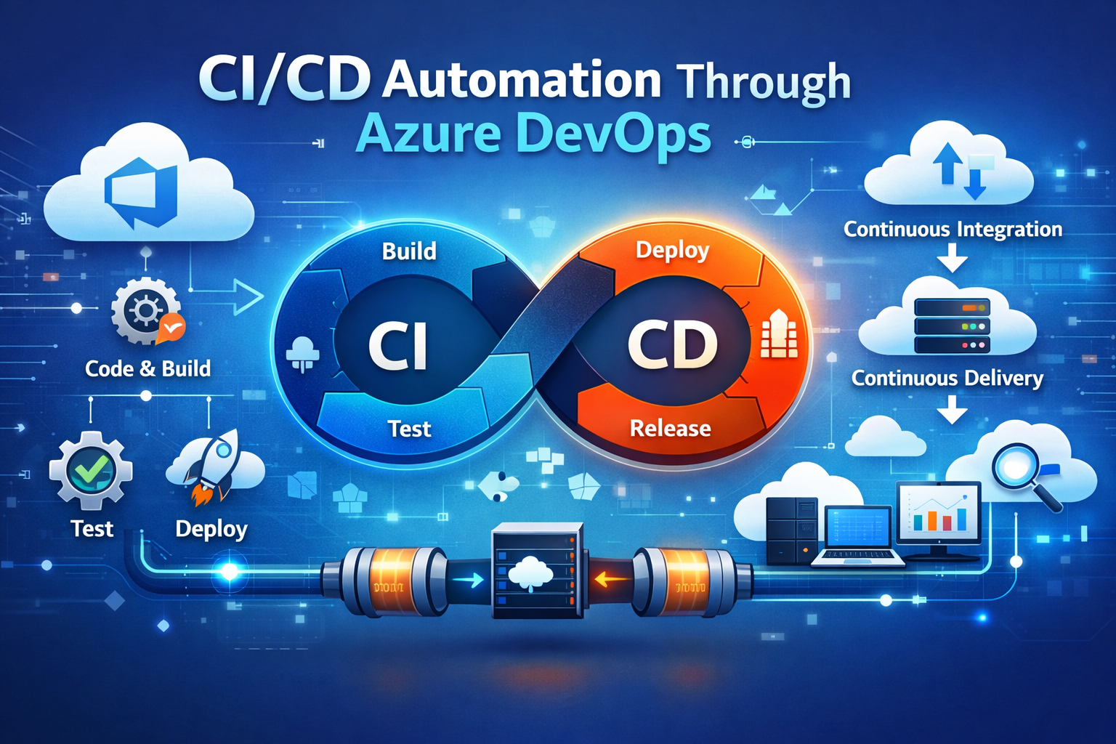
End-to-End Cloud-Native Deployment of Recruitment Micro services on Azure AKS
Group :
Mainak Das
Gourov Roy Choudhury
Amrita Sannigrahi

Slide 2
Flowchart for CI/CD Pipeline
Local Machine
Git repository
https://github.com/mainakdas73/Recruitment-App-Project
Builds image with Dockerfile and pushes to Azure Registry authenticated by Azure Service connections.
CI pipeline gets activated
CI pipeline updates the Values.yaml tag and commits to Git repository
Argocd monitors the git repository and reads the Helm chart and deploys the customized image by pulling it from Azure Registry to Kubernetes cluster

Slide 3
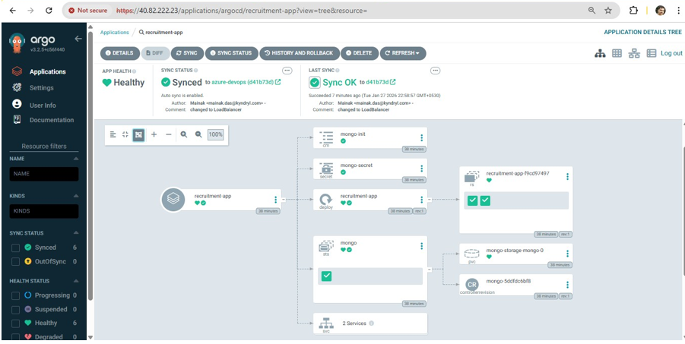
Argocd monitoring dashboard

Slide 4
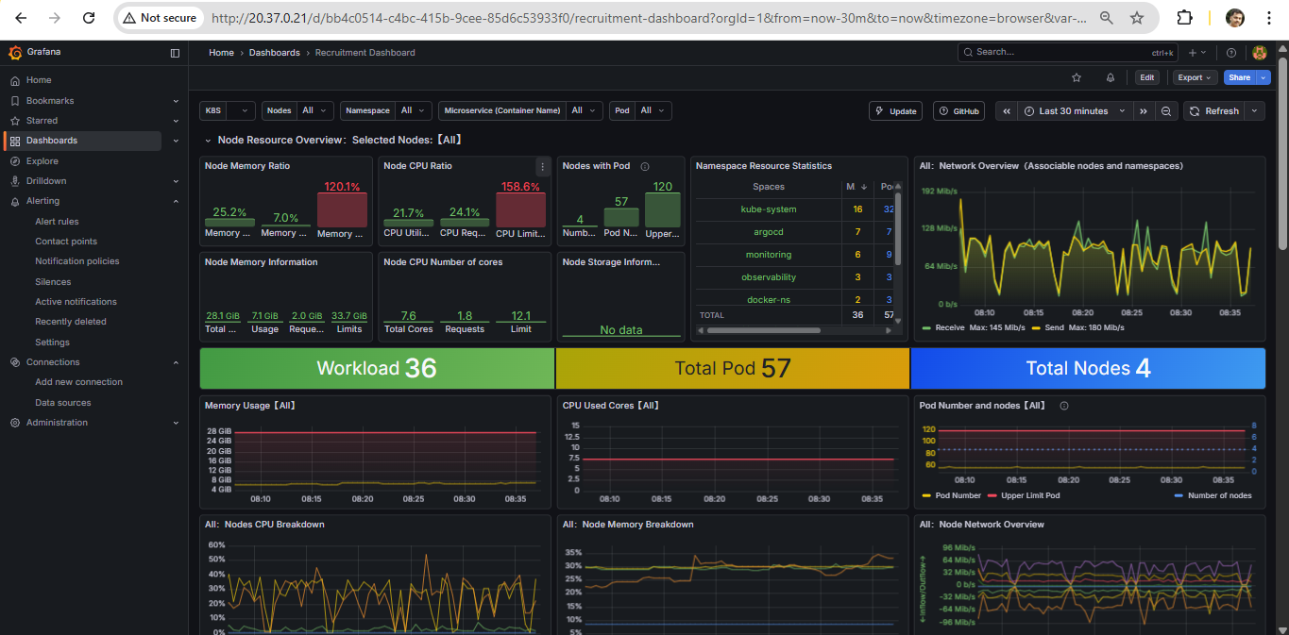
Grafana monitoring dashboard

Slide 5
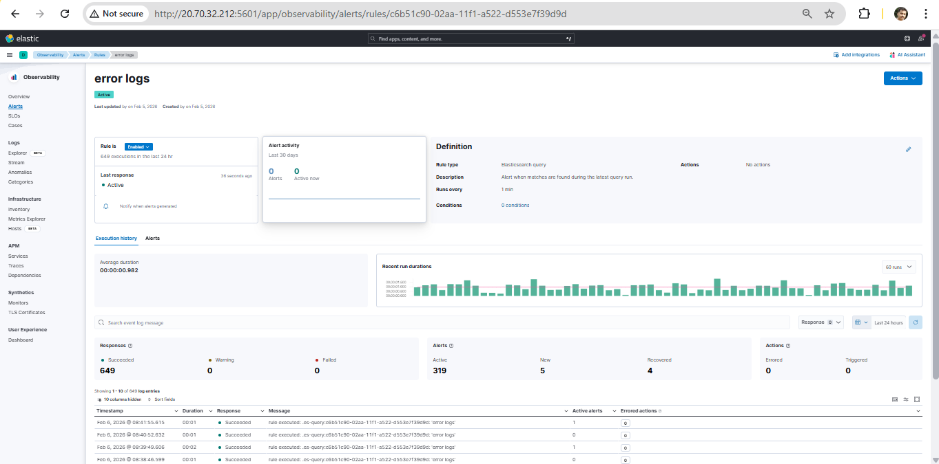
Kibana monitoring dashboard

Slide 6
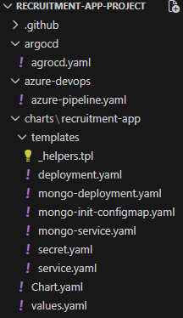
Source Codes
Dockerfile
FROM node:18-alpine
WORKDIR /app
COPY package*.json ./
RUN npm install --production
COPY . .
EXPOSE 3000
CMD ["node", "server.js"]
URL details:
Argocd - http://20.37.1.13
user name – admin
password - OeOOG5akdhyaJFqO
Grafana - http://20.37.0.21
user name - admin,
password - K8XpsnvHcP7U6uScE7IRGi6cuGb73EVhfFsz1BmT
Kibana – http://20.70.32.212:5601
Configurations:
https://github.com/mainakdas73/Recruitment-App-Project
Cluster Name – mainak-aks
Cluster Registry Name – acrmainak
Azure Resource Manager - recruitment-acr-connection
Docker Registry Service connection - recruitment-DR-connection

Slide 7


